Slide 1

FPGA Design for Embedded Systems
[Video Title]
[Instructor Name(s)]
[Department Name]
Hardware Description Languages for Logic Design
Copyright © 2019 University of Colorado

Slide 2
An Introduction to VHDL
VHDL is a widely used design language.
VHDL is a structured language for logic design.
In this Module we will introduce the VHDL language so that you can begin to design logic circuits.
Copyright © 2019 University of Colorado

Slide 3
Why learn VHDL?
VHDL is a structured language, and can be easier than Verilog to learn as your first Hardware Description Language.
Since VHDL is language based, designs created earlier can be re-used.
Copyright © 2019 University of Colorado

Slide 4
How can you learn VHDL?
Like any new language
If you were going to learn Spanish :
Learn key phrases
Learn Grammar and Syntax
Make more complex sentences
Practice, Practice, Practice
Copyright © 2019 University of Colorado

Slide 5
How would you write the VHDL code?
A 4-bit Comparator
A
B
Result
Copyright © 2019 University of Colorado

Slide 6
Videos in this Module
Why Learn VHDL (this video)
FPGA Design Flow
Intro to VHDL : Finite State Machine
How to speak VHDL, First phrases
VHDL Assignments, Operators, Types
VHDL Rules and Syntax, Interface Ports
Using VHDL in ModelSim : Download and Install
Using VHDL in Modelsim : Adding to your Toolkit
Copyright © 2019 University of Colorado

Slide 7
FPGA Design for Embedded Systems
[Video Title]
[Instructor Name(s)]
[Department Name]
Hardware Description Languages for Logic Design
Copyright © 2019 University of Colorado

Slide 8
Objectives
Acquire proficiency designing digital circuits with Field Programmable Gate Arrays (FPGA)s
Employ industry-standard tools to design and implement programmable logic solutions using several Hardware Description Language (HDL) design entry methods, including VHDL, Verilog and System Verilog
Build proficiency by designing basic digital programmable logic circuits in VHDL, Verilog and System Verilog
Copyright © 2019 University of Colorado

Slide 9
Recap: FPGA Design Flow
Design Entry: Schematic or HDL
Place and Route or Fitting
Timing Analysis and Simulation
Functional Simulation
Synthesis or Mapping
Programming the Device
Test and Integration
Release
Copyright © 2019 University of Colorado

Slide 10
FPGA Design Flow: Design Entry
Design Entry: Schematic or HDL
Place and Route or Fitting
Timing Analysis and Simulation
Functional Simulation
Synthesis or Mapping
Programming the Device
Test and Integration
Release
Copyright © 2019 University of Colorado

Slide 11
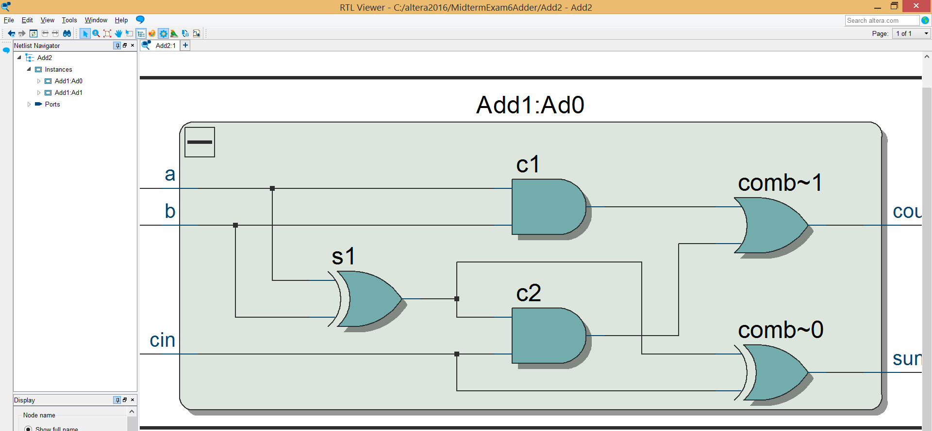

FPGA Design Entry Methodologies
Schematic Entry
Logical correlation between schematic design entry and circuit implementation
Not always transferrable between different FPGA tools and technologies
Difficult to scale for larger designs
Copyright © 2019 University of Colorado

Slide 12
FPGA Design Entry Methodologies
Hardware Description Languages (HDLs)
VHDL
Verilog
System Verilog
Copyright © 2019 University of Colorado

Slide 13
HDL Key Concepts
Describing a hardware circuit implementation that your tool chain will eventually interpret and synthesize into FPGA logic cells
HDL is concurrent, not sequential
FPGA logic cells are hardware; inherently executes in parallel
CPU code is software; inherently executes in sequence
Copyright © 2019 University of Colorado

Slide 14
Summary
Review the FPGA design flow
Explore FPGA design entry options
Introduce key concepts of using Hardware Description Languages (HDLs) to describe circuit implementations
Copyright © 2019 University of Colorado

Slide 15
Objectives
Establish motivation for learning VHDL
Introduction to VHDL coding
Reinforce key concepts
Copyright © 2019 University of Colorado

Slide 16
Why Learn VHDL?
Earn a great income writing VHDL for FPGA and ASIC devices
VHDL is more structured than Verilog and faster than schematic capture!
Learn a new language for efficient and reusable problem solving
Copyright © 2019 University of Colorado

Slide 17
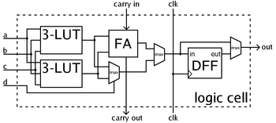
HDL Key Concepts
Describing a hardware circuit that will synthesize into FPGA logic cells or gates
Logic is concurrent, not sequential
FPGA gates are hardware; executes in parallel
CPU code is software; executes serially
[Video Title]
References: https://en.wikipedia.org/wiki/Field-programmable_gate_array
Copyright © 2019 University of Colorado

Slide 18
Finite State Machine Example
State encoding
S(Q1, Q0) = “00”, “10”
State table
INPUT : Reset, Run, Clk
OUTPUT : R Result
STATE : Current, Next
Reset
Current State |  | IN | Next State |  | OUT
Q1 | Q0 | Run | D1 | D0 | R
0 | 0 | 0 1 | 0 0 | 1 1 | 0 0
0 | 1 | 0 1 | 0 1 | 1 0 | 0 1
1 | 0 | 0 1 | 1 0 | 0 1 | 1 0
1 | 1 | 0 1 | 0 0 | 1 1 | 0 0
Reset
S0
---
R=0
Run
Run
Run
Run
S1
---
R=1
Copyright © 2019 University of Colorado

Slide 19
Finite State Machine Example
Current State |  | IN | Next State |  | OUT
Q1 | Q0 | Run | D1 | D0 | R
0 | 0 | 0 1 | 0 0 | 1 1 | 0 0
0 | 1 | 0 1 | 0 1 | 1 0 | 0 1
1 | 0 | 0 1 | 1 0 | 0 1 | 1 0
1 | 1 | 0 1 | 0 0 | 1 1 | 0 0
Copyright © 2019 University of Colorado

Slide 20
Finite State Machine Example
Reset
Reset
S0
---
R=0
Run
Run
Run
Run
S1
---
R=1
VHDL Description
Copyright © 2019 University of Colorado

Slide 21
Introduction to VHDL
VHDL describes hardware implementations
A VHDL design consists of
Entity : interface = input, output ports
Architecture : implementation = design logic
Example: AND gate
[Video Title]
Copyright © 2019 University of Colorado

Slide 22
Introduction to VHDL
-- (VHDL comment)
-- Import std_logic library
library IEEE;
use IEEE.std_logic_1164.all;
-- Entity
entity ANDGATE is
port ( A : in std_logic;
B : in std_logic;
Y : out std_logic);
end entity ANDGATE;
-- Architecture
architecture RTL of ANDGATE is
begin
Y <= A AND B;
end architecture RTL;
[Video Title]
Copyright © 2019 University of Colorado

Slide 23
Introduction to VHDL
Example: Basic Logic
[Video Title]
D
C
Y
A
E
B
Copyright © 2019 University of Colorado

Slide 24
Introduction to VHDL
-- (VHDL comment)
-- Import std_logic library
library IEEE;
use IEEE.std_logic_1164.all;
-- Entity
entity BasicLogic is
port (
A : in std_logic;
B : in std_logic;
C : in std_logic;
Y : out std_logic);
end entity BasicLogic;
-- Architecture
architecture RTL of BasicLogic is
Signal D, E : std_logic;begin
D <= NOT C;
E <= A OR B;
Y <= D AND E;
end architecture RTL;
Copyright © 2019 University of Colorado

Slide 25
Summary
VHDL is a structured language
Entity and Architecture pairs
Gates synthesized into hardware operate concurrently and in parallel
Copyright © 2019 University of Colorado

Slide 26
Objectives
VHDL Assignments : signals and variables
Operators : add, multiply, and everybody shift to the left
Copyright © 2019 University of Colorado

Slide 27
VHDL Assignments
Signals
Signal wire to the entity : std_logic
Scheduled update
<= signal assignment operator
Z <= A and B; -- concurrent, gates silicon
Z <= D after 5ns; -- sequential, simulation
Variables
Variable only within the process : integer
Immediate update
:= variable assignment operator
count := count +1; --simulation loop counter
a := 27; -- variable assignment
Copyright © 2019 University of Colorado

Slide 28
Select Assignment
entity mux_4 is port(
a, b, c, d: in std_logic_vector(3 downto 0);
s: in std_logic_vector(1 downto 0);
x: out std_logic_vector(3 downto 0));
end mux_4;
architecture sel_arch of mux_4 is
begin
with s select
x <= a when “00”;
b when “01”;
c when “10”;
d when “11”;
d when others;
end sel_arch;
References: Kevin Skahill, VHDL for Programmable Logic.
Menlo Park, CA, Addison-Wesley, 1996, pp. 166
Copyright © 2019 University of Colorado

Slide 29
Conditional Assignment
architecture sel_arch of mux_4 is
begin
x <= a when ( s =“00”) else
b when ( s =“01”) else
c when ( s =“10”) else
d;
end sel_arch;
References: Kevin Skahill, VHDL for Programmable Logic.
Menlo Park, CA, Addison-Wesley, 1996, pp. 166
Copyright © 2019 University of Colorado

Slide 30
Process Assignment
architecture sel_arch of mux_4 is
begin
mux_proc: process(a, b, c, d, s)
begin
if s = “00” then x <= a;
elsif s = “01” then x <= b;
elsif s = “10” then x <= c;
else x <= d;
end if;
end process mux_proc;
end sel_arch;
References: Kevin Skahill, VHDL for Programmable Logic.
Menlo Park, CA, Addison-Wesley, 1996, pp. 166
Copyright © 2019 University of Colorado

Slide 31
VHDL Operators
Operators
** exponent abs absolute value
not complement + - add or subtract
* multiply / divide
mod modulo rem remainder
sll, srl shift left, right
rol, ror rotate left, right
=, /=, <, <=, >, >= equality, greater, less than
and, or, nand, nor, xor, xnor
Order precedence
Left to right, Parenthesis
Unary single operand on right mod A
Binary operators on both sides A+B
[Video Title]
Copyright © 2019 University of Colorado

Slide 32
Data Types – scalar and array types
Array
string “abc”
bit_vector “1001”
std_logic_vector “101Z”
Scalar
character ‘a’
bit ‘1’, ‘0’
std_logic ‘1’, ‘0’, ‘X’, ‘Z’
boolean true, false
real, integer 3.14 1E+0, 27
time fs, ps, ns, us, ms
Copyright © 2019 University of Colorado

Slide 33
Summary
VHDL Assignments : signal and variable
Logical Select
Operators - Dial 0
Scalar and Array data types
Copyright © 2019 University of Colorado

